Slide 1

Object Oriented Paradigm

Slide 2
Object and Class
What is Object?
    Any real life entity which has properties and behaviours
    Instance of class
    Variable of UDT( User defined type)
What is class?
    Blueprint for Object
    A programming construct which defines objects properties and behaviour. Class define data access policy using public, private and protected keywords.
    Definition of UDT( User defined type)

Slide 3
Object Oriented Paradigm
Object oriented Paradigm has Object Oriented Principles
  Object Oriented Principles
    Encapsulation
    Inheritance
    Polymorphism
    Cohesion
    Coupling
  Programming practices
    Data abstraction
    Data Handling

Slide 4
Object Oriented Principles
Encapsulation:
  binding data members with member functions of object.
  binding properties with behaviours of object.
  Inheritance:
  Creation of new object by acquiring common properties and behaviours and extending behaviour of parent object if required.
  Generalization to Specialization

Slide 5
Object Oriented Principles
Polymorphism:
  many forms of same thing
  different behaviour for different caller
Coupling:
  Interaction between different objects( Message passing)
  Coupling should be low
  Cohesion:
  Interaction within object
  Cohesion should be high( Self sufficient object)

Slide 6
Programming practices
Data Abstraction:
  Knowing required details about Object
  Never details about how the object performs behaviours
Data Hiding:
  Controlling the accessibility of objects data( Properties and behaviours)
  Hiding details from outside world.

Slide 7
Syntax for Class
class <class_name>
{
private:
<Data members>;
<Members functions>;
protected:
<Data members>;
<Members functions>;
public:
<Data members>;
<Members functions>;
}; // Terminating semicolon is extremely required.

Slide 8
First Example of Class and Object
Create a class to denote complex numbers and implement behaviors.
Task List
  Create class with data members and member functions.
  Write main function
    Create Object
    Call member functions

Slide 9
First Example of Class and Object
#include<iostream>
using namespace std;
class Complex{
private:
int i;
int j;
public:
void Accept(){
cout<<"Enter real & img part"<<endl;
cin>>i>>j;
}
void Display(){
cout<<"I="<<i<<"\nJ="<<j;
}
};
int main(){
Complex c1;
c1.Accept();
c1.Display();
return 0;
}

Slide 10
Object graphical representation of Complex class object
i
j
10
20
c1
8080
8084

Slide 11
Properties of class
Default access specifier inside class is private.
private data members can be accessed within class only
protected data members can be accessed within class and inside child classes
public data members can be accessed anywhere
Size of class /object is sum of sizes of all data members
Size of empty class is 1 byte

Slide 12
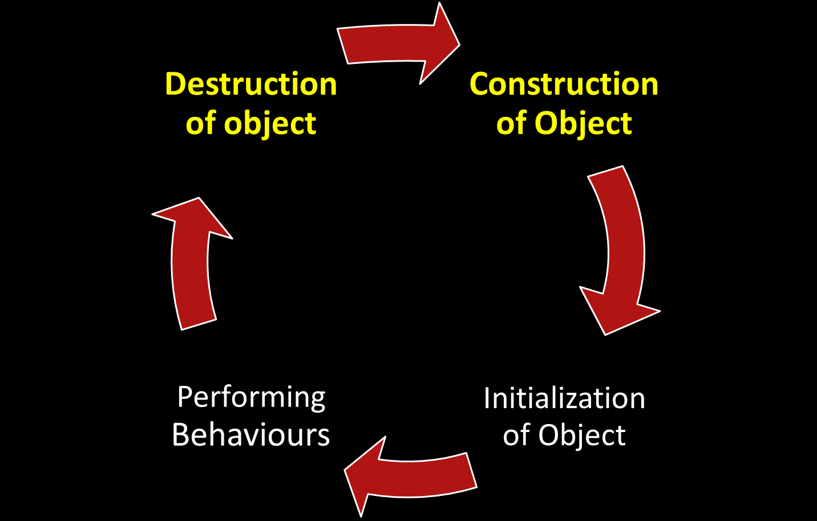
Life Cycle of an Object

Slide 13
Constructor (ctor)
Constructor is special member function with same name as class and with or without arguments but no return type.
Constructor is used to initialize object
If programmer do not write ctor for class, complier automatically inserts default ctor( 0 args ctor)
Types of Constructors
  Default ctor ( 0 arguments)
  Parameterized ctor / Conversion ctor( with args)
  Copy ctor

Slide 14
Constructor Examples
#include<iostream>
using namespace std;
class Complex{
private:
int i;
int j;
public:
Complex() // Default ctor
{ i=0;
j=0; }
Complex(int p, int k)
{ i=p; //Parameterized ctor
j=k; }
void Accept(){
cin>>i>>j; }
void Display(){
cout<<"\n"<<i<<" "<<j; }
};
int main(){
Complex c1; // Default constructor call
Complex c2(10,10); // Parameterized ctor
c1.Display();
c2.Display();
return 0; }
// If programmer implements any constructor compiler will not provide default constructor

Slide 15
Constructor with initialization List
Constructor with initialization List does pure initialization
Constant data members can only be initialized using ctor with initialization list
Array data members can not be initialized using ctor with initialization list
Complex() { // Default ctor
i=0;
j=0; }
Complex() : i(0),j(0){ // Ctor with initialization list
}

Slide 16
Constructor with initialization List
#include<iostream>
using namespace std;
class Sample{
private:
int arr[3];
public:
// Sample(): arr[0](0)
// { } // Error at above line
Sample(){ // Array D.M init in ctor
for(int i=0;i<3; i++){
arr[i] =i;
}}
//Array D.M init is not possible with ctor with init list
void Display() {
for(int i=0;i<3; i++){
arr[i] =i; }
}
};
int main()
{ Sample s;
s.Display();
return 0;
}

Slide 17
Different ways to create and init object
Assuming Complex class is implemented with Default and parameterized constructor (Refer Slide no.12)
int main(){
Complex c1;
Complex c2(12,12);
Complex c3 = c1; // Copy ctor
Complex c4(c2); //Copy ctor
Complex c5 = Complex();
//Copy ctor
Complex *cp = new Complex;
Complex *cp2 = new Complex(5,5);
c2.Display(); //Obj need . (dot)
cp2->Display(); //Ptr need ->
return 0;}

Slide 18
Array of Objects
int main(){
Complex carr[3]; // Static array
for(int i=0; i<3; i++){
carr[i].Accept();
}
for(int i=0; i<3; i++){
carr[i].Display();
}
return 0; }
int main(){
Complex *cp = new Complex[3];
for(int i=0; i<3; i++){
cp[i].Accept();
} //cp[i] is object hence . opr
for(int i=0; i<3; i++){
cp[i].Display();
}
return 0; }

Slide 19
Thank You
Think about Objects around you!!!! ……….OOP

